Slide 1
SoyKB and KBCommons: Enabling data mining, farming and harvesting in the Cloud
Dr. Trupti Joshi
Assistant Professor
Department of Health Management and Informatics
School of Medicine
Core Faculty MUIDSI, EECS, IPG, LSC
University of Missouri - Columbia

Slide 2
Outline
Introduction
Translational Bioinformatics Tools and Genomic Solutions
SoyKB and KBCommons Knowledge Bases
PGen Workflow & SNPViz v2.0
Soybean Allele Catalog
IMPRes Algorithm and Tool
G2PDeep Method

Slide 3
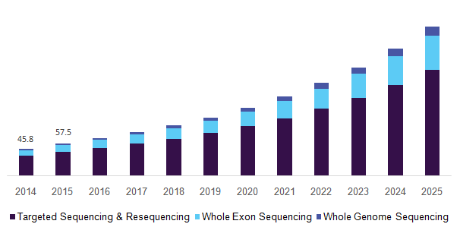
Next Generation Sequencing (NGS)
NGS technology has transformed research conducted at molecular levels, making it feasible to perform whole genome scale multiomics studies.
NGS sequencing decreasing costs have and will continue to generate plethora of data for research and applications.

Slide 4
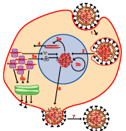
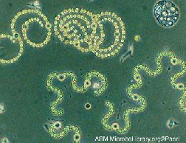
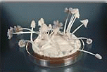
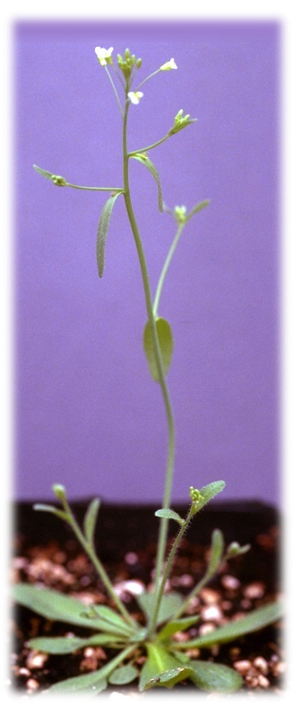
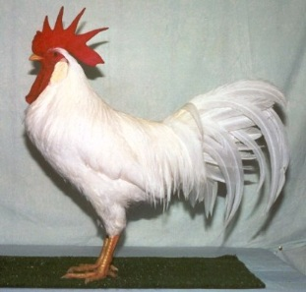
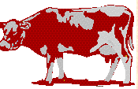
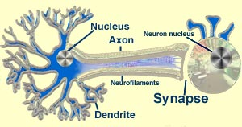
Various Living Organisms
Viruses
Microbes
Nematode
Fungi
Plants
Insects
Fishes
Chicken
Chimpanzee
Mouse/Rat
Human
Dog
Pig
Neurons
Cow

Slide 5
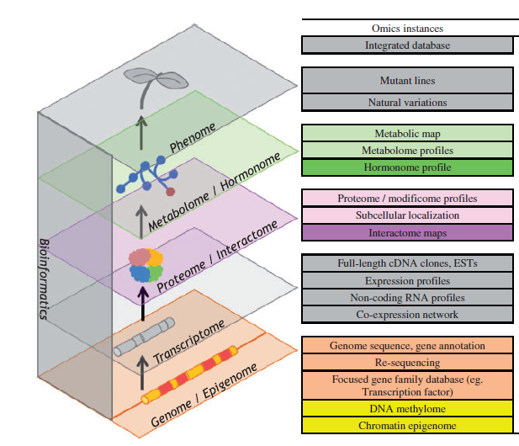
Genomics and Multiomics Datasets
Informatics and Computational methods have rapidly become an essential component for all biological, plant science, animal science and biomedical studies!

Slide 6
What’s The Challenge?
It is the amount & the diverse nature of biological data generated by such high-throughput technologies that need to be integrated together, to convert data into meaningful knowledge and making novel discoveries!
Multiomics data are often individually scattered across different databases and repositories, making it difficult for its users to access them efficiently.

Slide 7
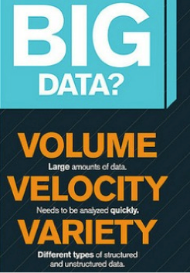
Precision Medicine
Predicting the disease before it strikes
Explaining the rare disease that defies experts
Finding the drugs for diseases lacking attention
Discover disease associated genes and disease causing genes
Identify patients who respond optimally
Provide an amazing platform for biomedical innovation
Many more….

Slide 8
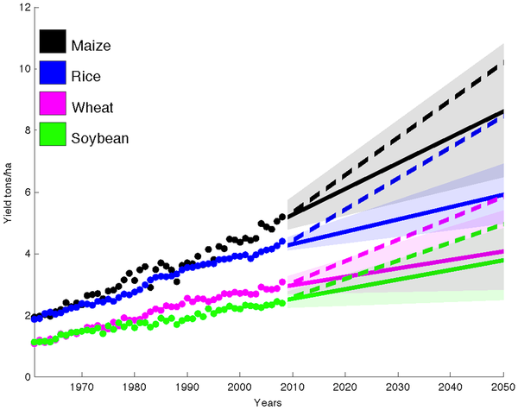
Food Security
With the world population projected to cross 9.7 billion by the year 2050, global crop production needs to double by 2050 to meet the projected demands from rising population, diet shifts, and increasing biofuels consumption.
Boosting crop yields to meet these rising demands, rather than clearing more land for agriculture has been highlighted as a preferred solution to meet this goal.
Informatics plays an important role in providing solutions, through mining of the crop germplasm genomic information, data sharing, targeted breeding to improve the crop production and Precision Agriculture.
Yield Trends Are Insufficient to Double Global Crop Production by 2050
Ray et. al. 2013, Plos One

Slide 9
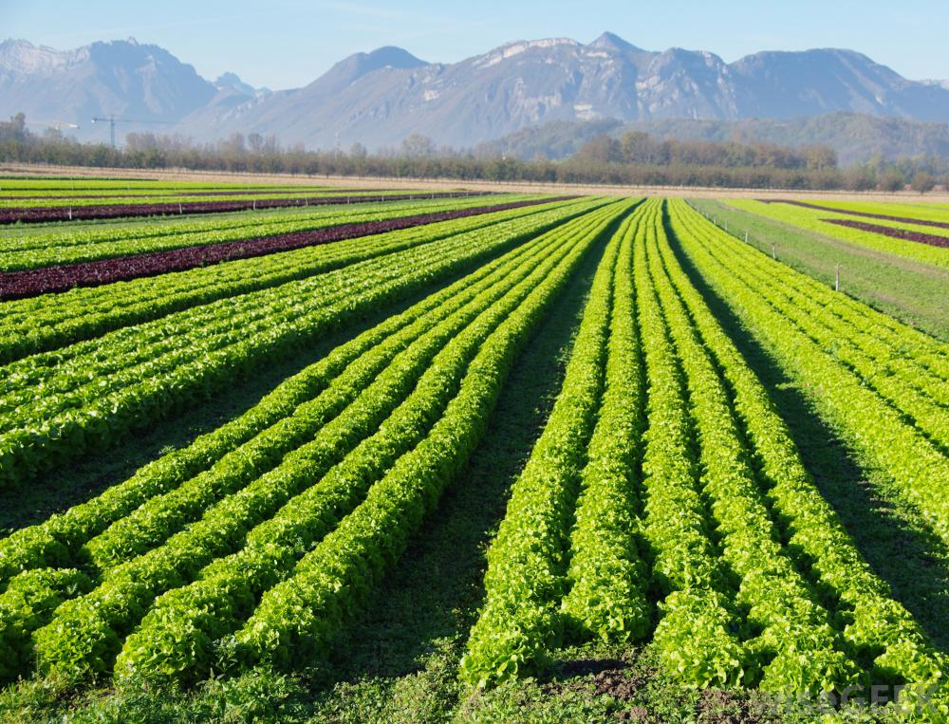
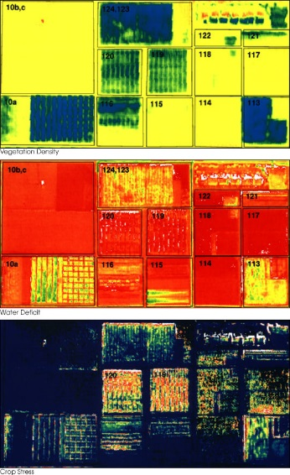
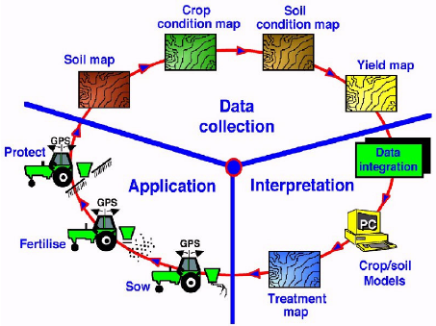
Precision Agriculture
Precision agriculture is one of many modern farming practices that make production more efficient.
Decisions based on many Agronomic Data
Hybrid selections, Plant populations
Yield data , Soil data
Pesticide, Fungicides
Genotypes, Environments
Economics, Market Prices
Data generated can be utilized and applied for selected breeding, improving yield, pest management, crop disease analytics, spraying decisions and many more.
Comparetti et al. 2015

Slide 10
The Model Has Changed!
The Model of Generating/Consuming Data has Changed
Old Model: Few organizations are generating data, all others are consuming data
New Model: All of us are generating data, and all of us are consuming data

Slide 11
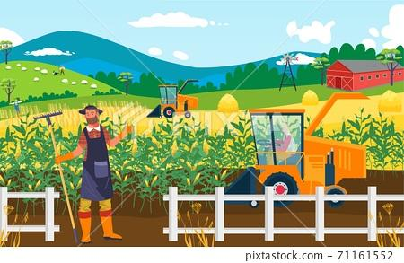
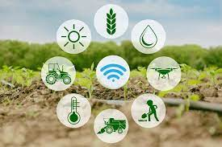
Modern Farming
Modern day farming and agriculture is as much about data, as it is about digging and harvesting !!

Slide 12
Data Explosion in Agriculture
There are lots of terms involving data that are being tossed around these days. Data analytics. Data mining. Data harvesting. Data science. Data integration……. And that’s just scratching the surface.
It’s no exaggeration to say that the explosion of data has transformed the world as more information is available for collection and analysis than ever before.
This has resulted in the development of Data repositories. Data marts. Data warehouses. Data lakes.……And the list goes on!!

Slide 13
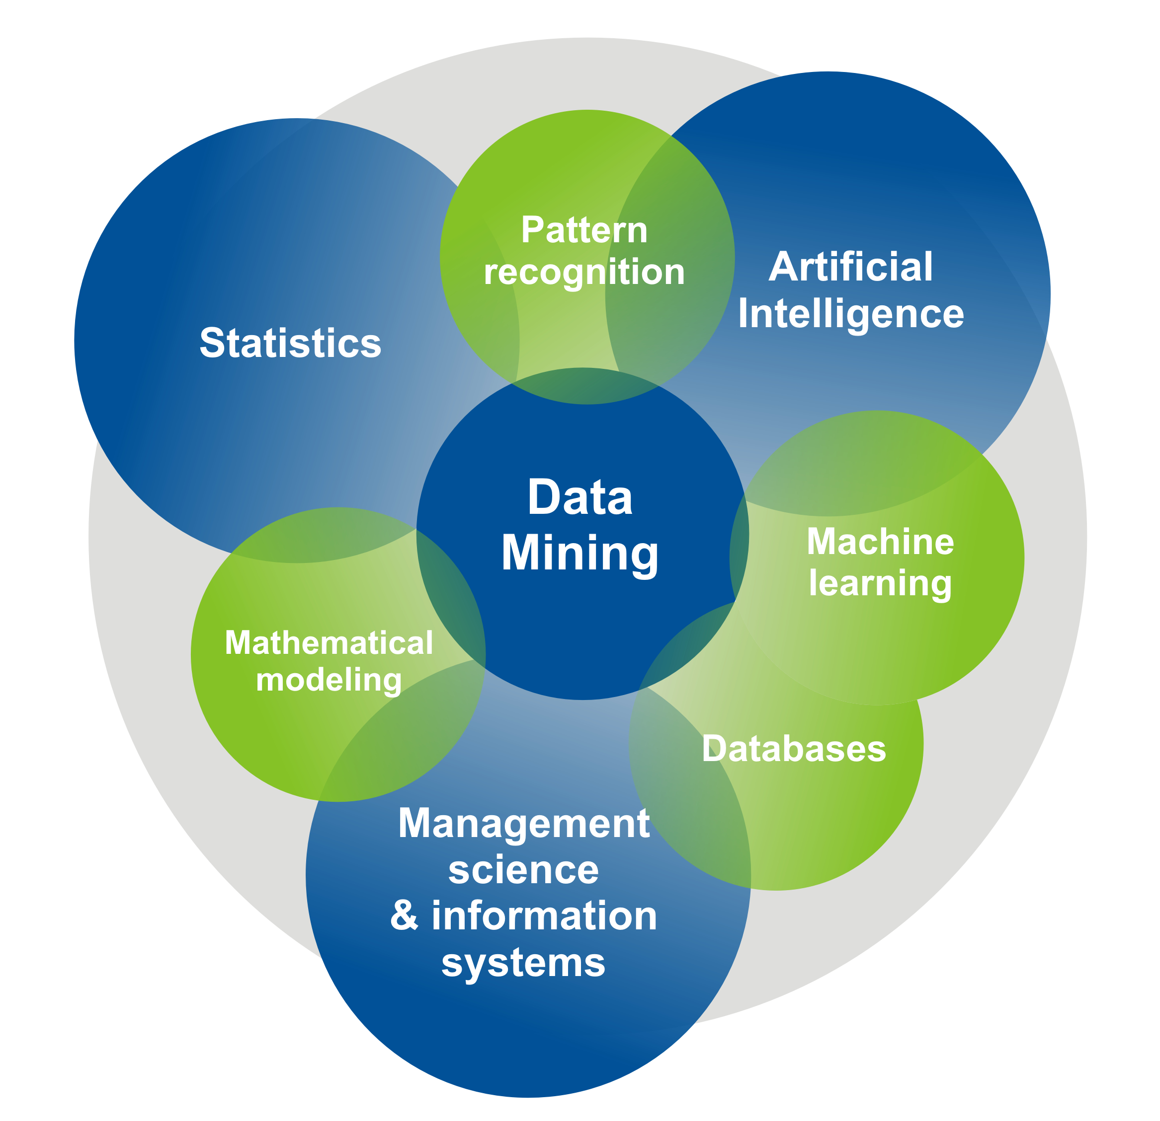
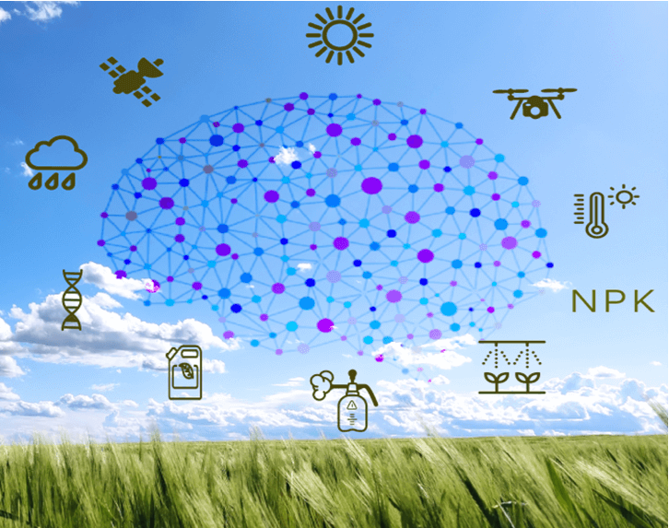
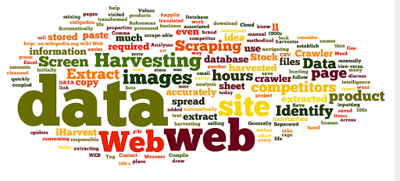
Data Mining, Farming and Harvesting
Data mining is the process of digging through already generated or collected data sets to find patterns, correlations, and trends. Similar to a miner that digs in the earth to find gems.
Data farming is cultivating and acquiring data specifically for forecasting and modeling.
Data harvesting is the process that extracts and analyzes data collected from online sources. It derives from the agricultural process of harvesting, wherein a good is collected from a renewable resource.

Slide 14
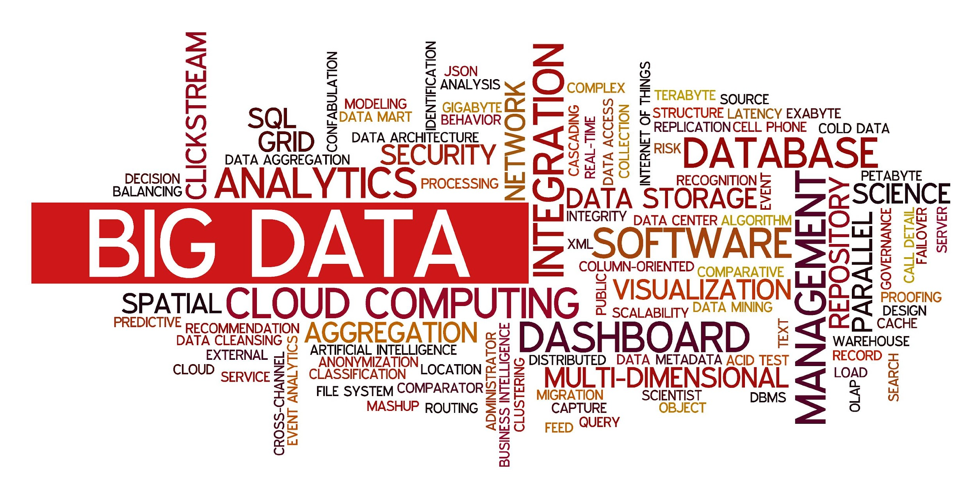
BIG Data In Agriculture

Slide 15
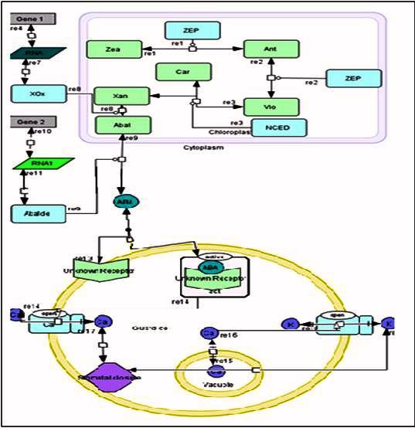
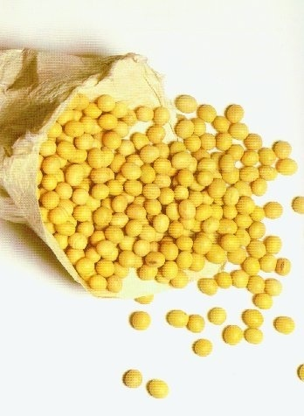
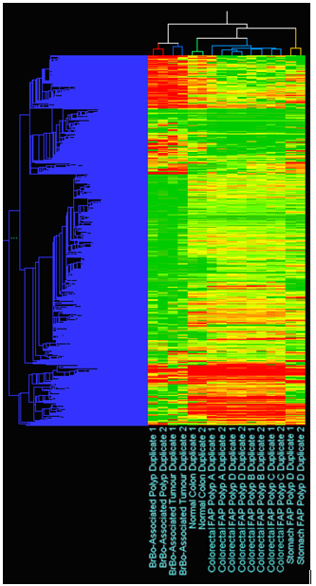
Enabling Translational Research
Genomic-scale Data:
NGS Genome sequence
Transcriptomics
Proteomics
Metabolomics
Genomic Variations
Knowledge:
Gene function
Gene regulation
Drought resistant gene
Pathway
Networks
Phenotypes:
Plants & Crops
Animals & Pets
Human & Diseases
Microbes & Viruses
Data volume: huge
Data access: spread
Data complexity: high
Transform Data into Knowledge with Informatics Algorithms, Tools & Databases
Precision Agriculture
Precision Medicine
One Health
Biomarker Discovery
Notes:
‹#›

Slide 16
Outline
Introduction
Translational Bioinformatics Tools and Genomic Solutions
SoyKB and KBCommons Knowledge Bases
PGen Workflow & SNPViz v2.0
Soybean Allele Catalog
IMPRes Algorithm and Tool
G2PDeep Method

Slide 17
Soybean Knowledge Base (SoyKB)
SoyKB is a comprehensive all-inclusive, “one-stop-shop” web resource bridging soybean translational genomics and molecular breeding
SoyKB provides integration of multi-omics data types including
- Epigenomics - Genomics
- Transcriptomics - Proteomics
- Metabolomics - Phenomics
SoyKB provides access to analytics linked to XSEDE HPC and cloud data storage on Cyverse
Has 500+ registered users across academic and Industry all over the world
https://soykb.org
Joshi et al. Plant Genomics Databases 2016; NAR 2014; BMC Genomics 2012.

Slide 18
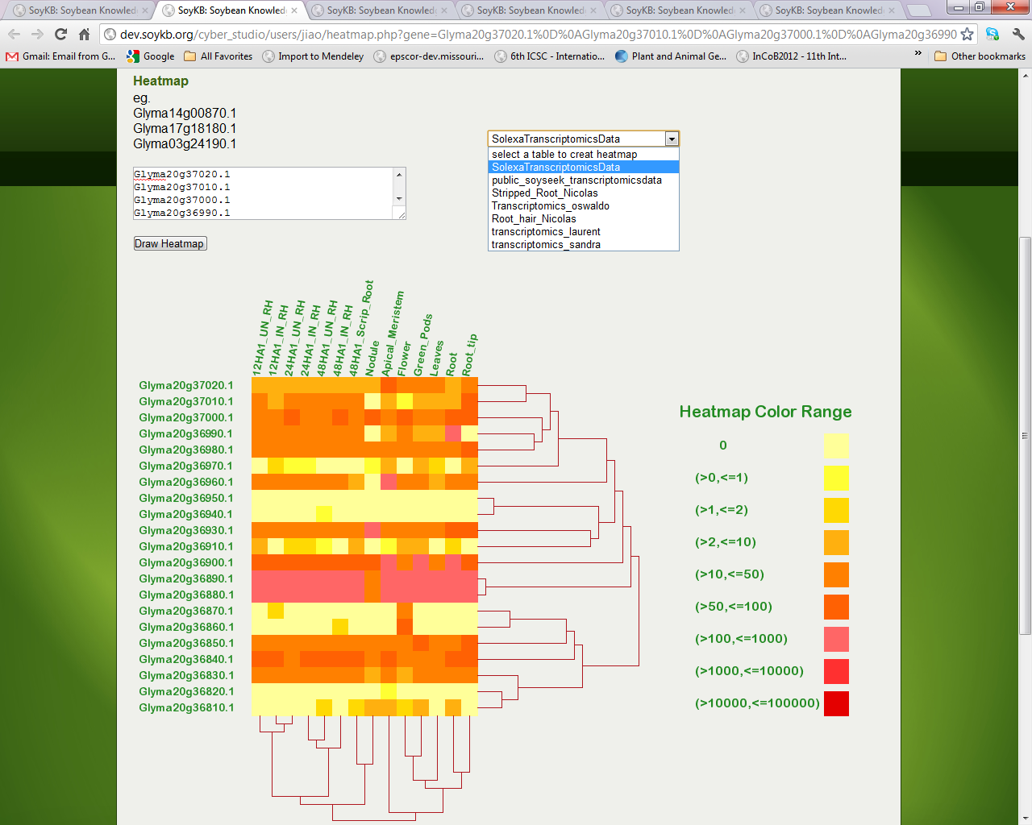
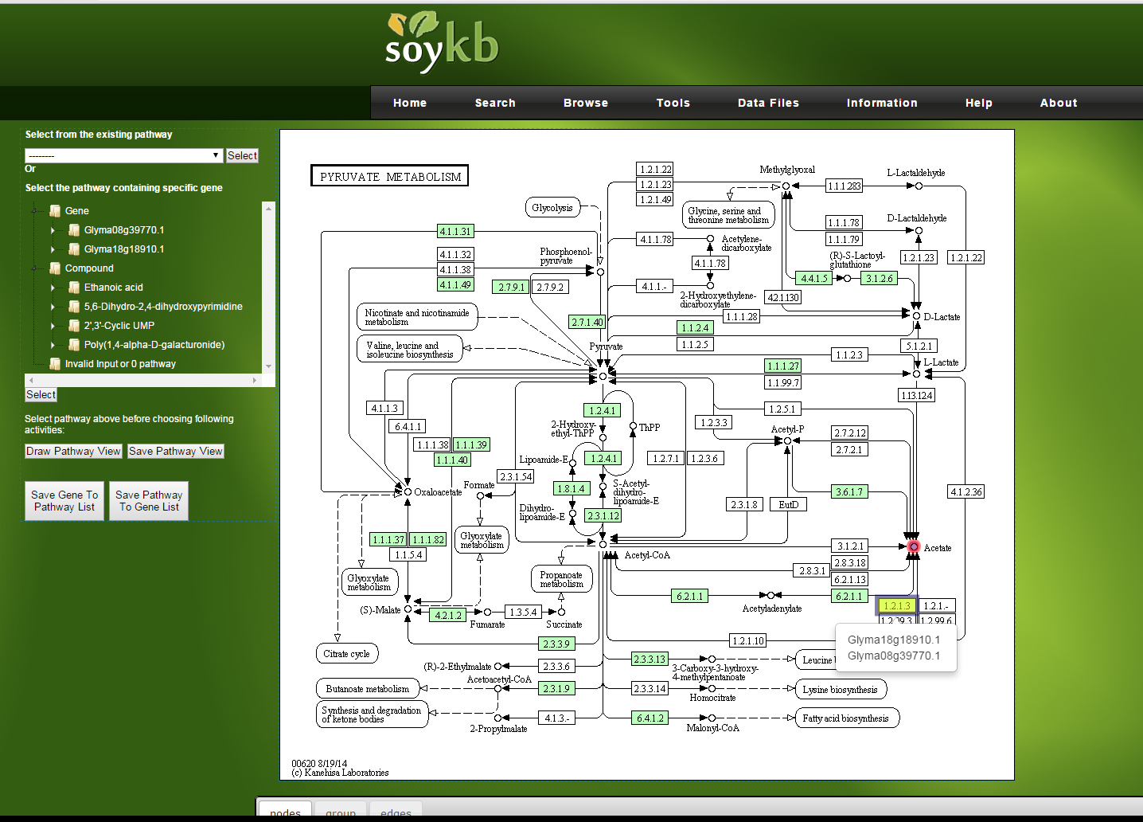
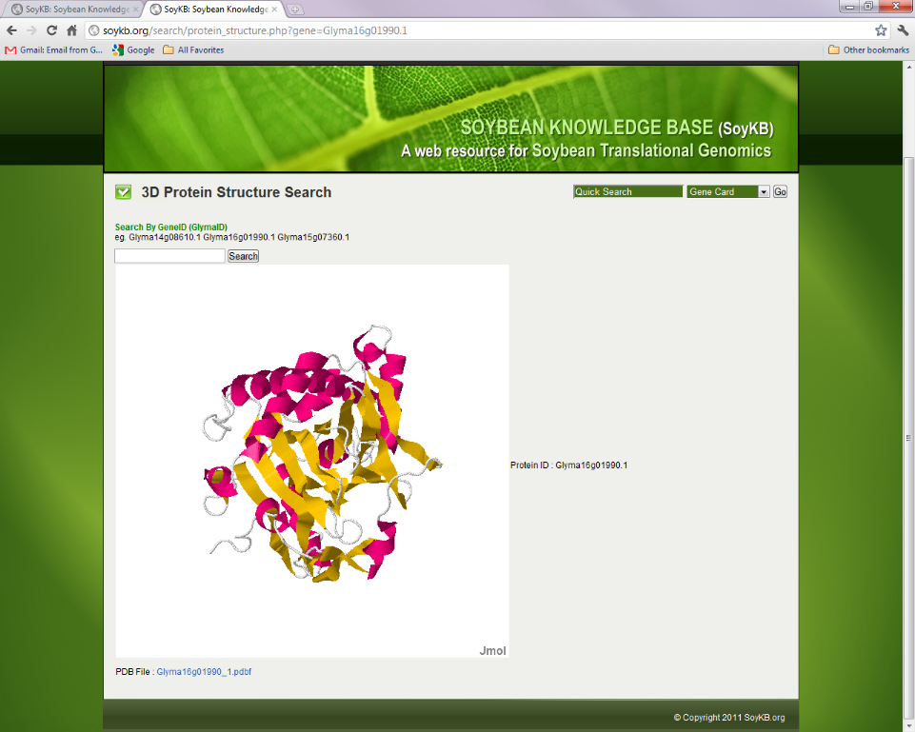
Heatmap and Hierarchical Clustering
Pathway Viewer
3D Protein Structure Viewer
eFP Browser
Useful Tools

Slide 19
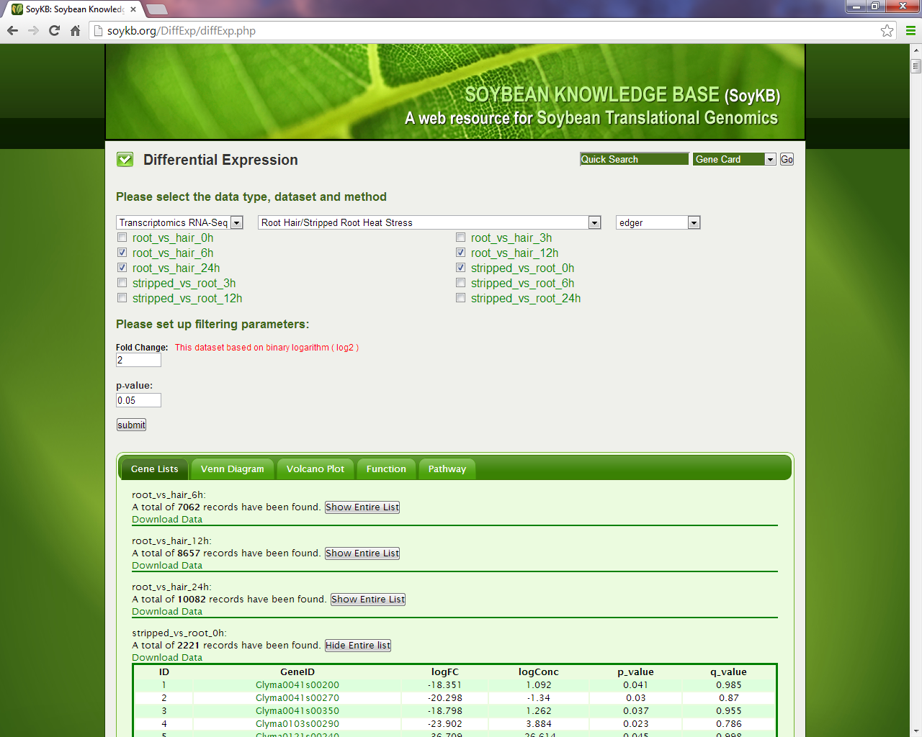
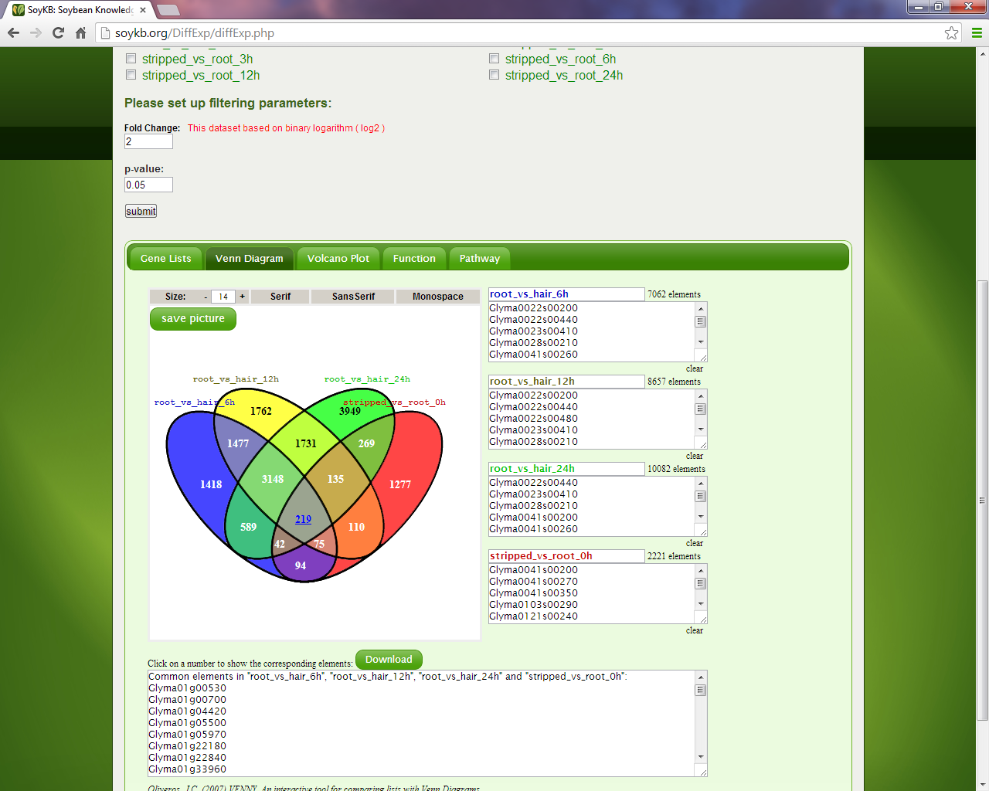
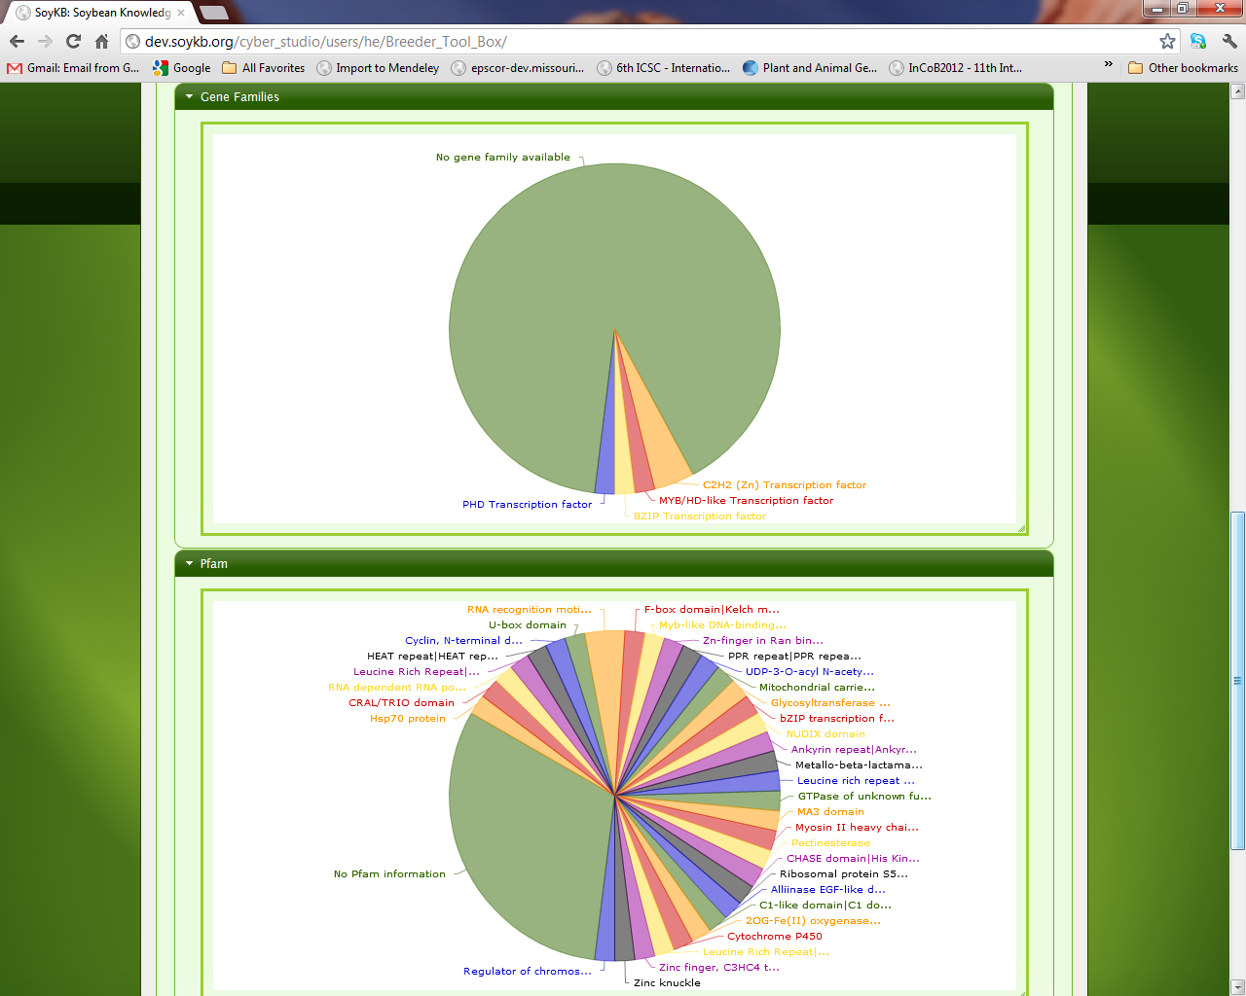
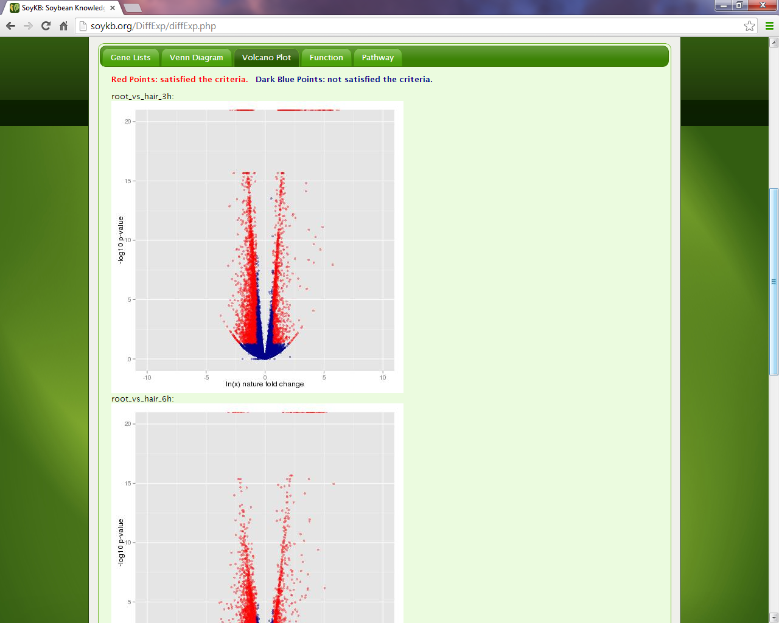
Differential Expression Gene Lists
Venn Diagrams
Differential Expression Suite of Tools
Useful Tools
Function Annotation Pie Charts
Volcano Plots

Slide 20
Suite of Informatics Tools
List of Analytical and Visualization Tools to become available through KBCommons Framework for all organisms
Protein 3D Structure Viewer
Co-expression analysis for genes/metabolites
Gene/Metabolite Pathway Viewer
Missouri Genome Browser
Chromosome Visualizer for QTLs and Traits
Motif Prediction and Web Logo Creator
Gene Families Browser
Phosphorylation data
Differential Expression Analysis for RNA-seq, Proteomics, Metabolomics
eFP gene expression Browser
In Silico Breeding Program
Heatmap and Hierarchical Clustering
Sequence Similarity and Phylogeny Tool
SNPViz Tool
Genotype to Phenotype Prediction Tool
NGS Resequencing data browser
Bulk download and upload capacity
Open Source and In-house developed tools
Notes:
List of Informatics analytics and visualization tools incorporated in Knowledge Base framework
Some open source and many in-house developed tools using Javascript, Ajax and PHP

Slide 21
KBCommons Informatics Framework
Knowledge Base Commons (KBCommons) comprehensive framework providing web based access for
Storage, management, sharing, analysis, integration and visualization of genomics and multi-omics data.
Adopts, expands and customizes our SoyKB tools for other model organisms, crops, animals and biomedical diseases.
Provides seamless links to HPC and cloud resources and integration of in-house developed suites of graphical visualization tools.
Applicable to various important species including:
Plant & Crops (Maize, Arabidopsis, Medicago)
Animal & Pets (Mouse, Rat, Dog)
Human & Diseases (Cancer, Endometriosis)
Microbes & Viruses (SARSCov2)
SoyKB : Soybean Knowledge Base

Slide 22
KBCommons Architecture
KBCommons is implemented using Laravel-PHP framework, Javascript, PHP, MySQL and MongoDB databases.

Slide 23
KBCommons Architecture
(4)
(2)
(3)
(1)

Slide 24
KBCommons Homepage
https://kbcommons.org/
Zeng et al. 2018. BIBM; 2019 BMC Genomics

Slide 25
KBCommons – Key Features
KBCommons supports creation of new KB, contributing multiomics data to KB, adding new genome version to established KBs and browsing KB
Provides a universal framework for all organisms
Available for various important species including:
Plant & Crops (Maize, Arabidopsis, Medicago)
Animal & Pets (Mouse, Rat, Dog, Worm)
Human & Diseases (Cancer, Endometriosis)
Microbes & Viruses (HIV, B. japonicum, SARSCov2)

Slide 26
KBCommons – Create New KB
1. Fill organism and version
2. Upload six essential files
3. Browse KB or Upload Multiomics Data

Slide 27
KBCommons – Contribute to KB
1. Fill organism and version
2. Upload OMICS data
3. Data Submit

Slide 28
KBCommons – Add New Genome Version
Preferred Data Sources
Plants
Other Organisms
Guides through next steps to upload files similar to the “Creation of New KB”
Standardized Formats

Slide 29
KBCommons – Browse KB

Slide 30
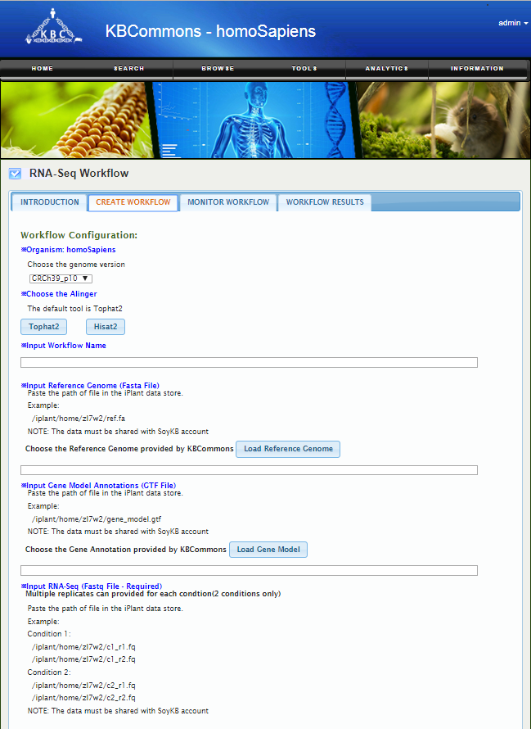
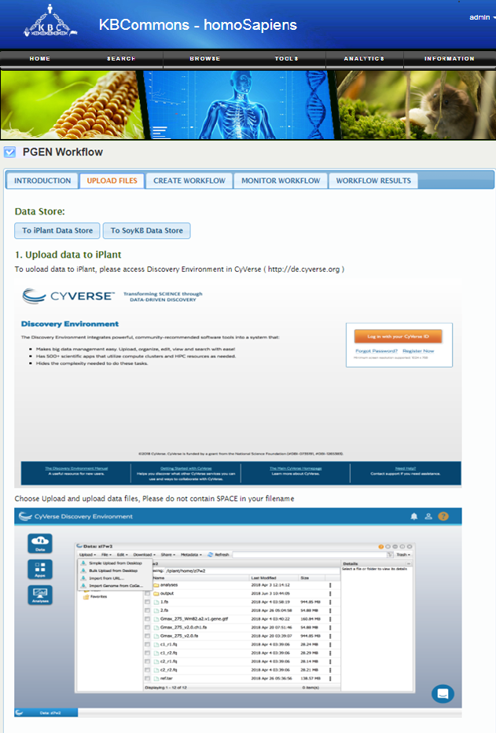
KBCommons – Browse KB Analytics
RNASeq Workflow
PGen Workflow

Slide 31
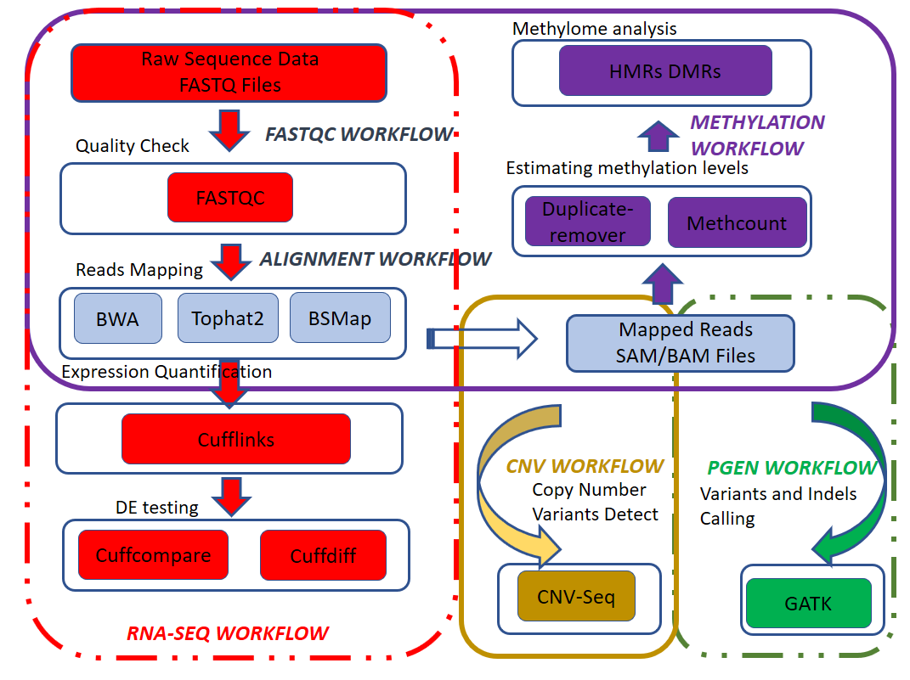
Bioinformatics Workflows
KBCommons – OntimeURB Analytics
OntimeURB in KBCommons allows automated suggestions and customization of cloud computational resources factoring in user preferences of Security, Performance, Agility and Cost based on the scale and type of selected analytics workflows
PGen – SNP and Indel
RNA-Seq
NGS Alignment
FastQC
CNVSeq
Methylation
Single cell RNAseq
Exome sequencing*
Microbiome*
* Under Development
Pandey et al. 2019. BIBM
Singh et al.
2020. BIBM
Pandey et al. 2021 Submitted

Slide 32
KBCommons – Diverse Applications
KBCommons framework currently supports diverse applications including
CancerKB, EndometriosisKB & other DiseaseKBs - Precision Medicine
CyNeuro - NeuroScience Research
MaizeKB and other CropKBs - Precision Agriculture
Future Proposed Applications
MetaboliteKB
Cross-species Multiomics Translational Research

Slide 33
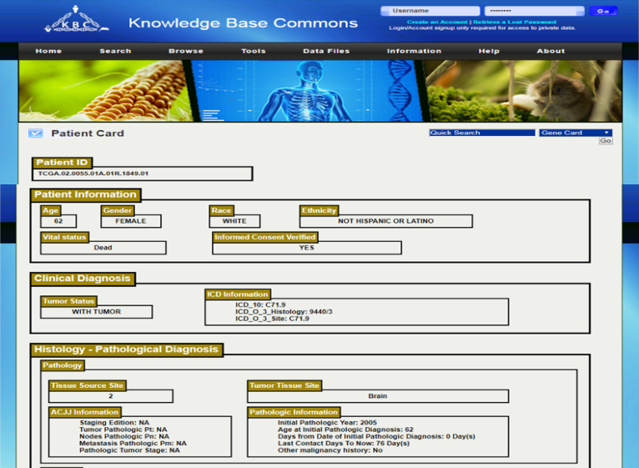
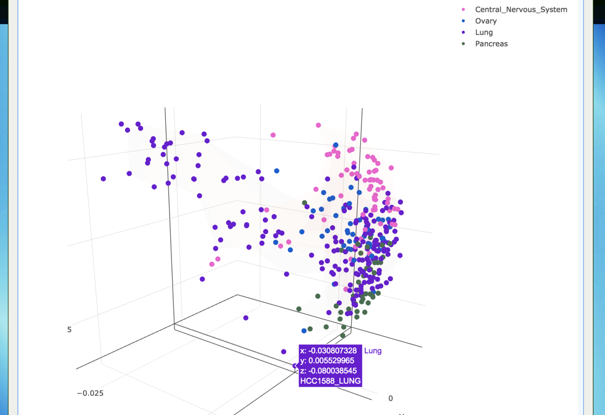
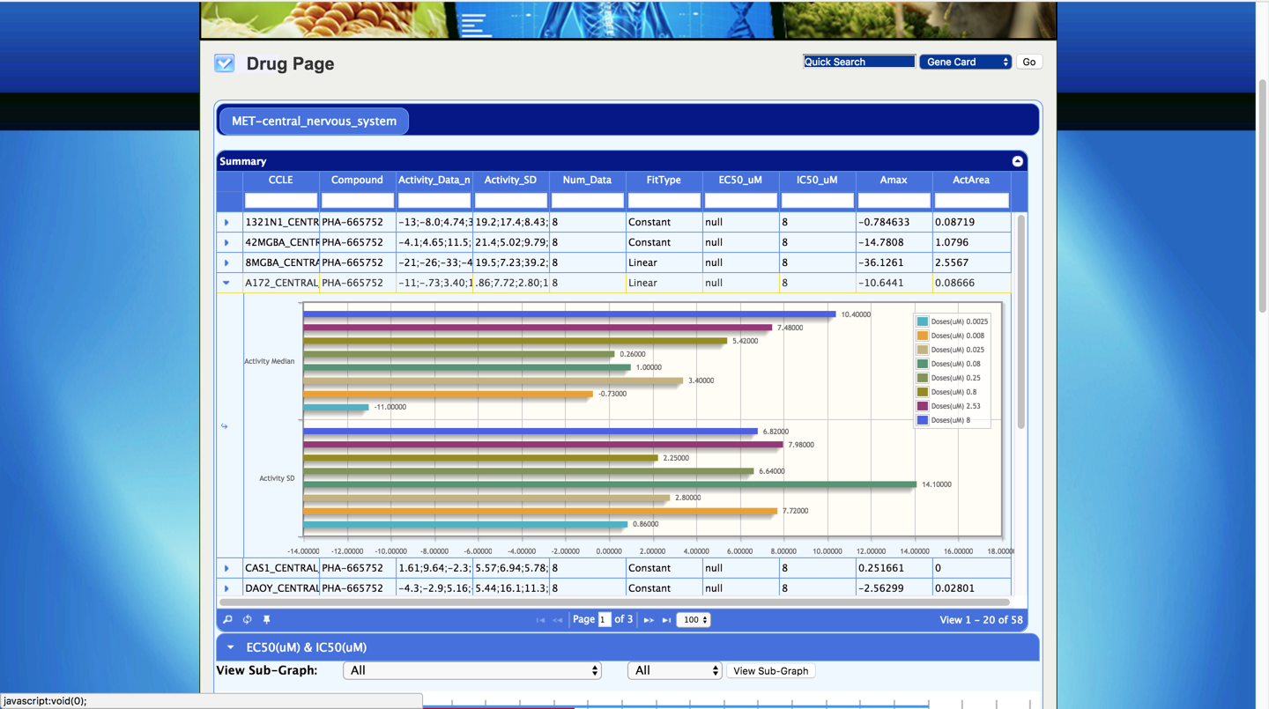
CancerKB Informatics Tools
24 Cancers TCGA Patients Datasets and 1046 CCLA Cancer Cell Lines Datasets
Patient Clinical Information
Patient Oncogenes Expression
Population Oncogenes Expression
PATIENT
(TCGA)
CANCER CELL LINE
(CCLE)
Principal Component Analysis
Gene Copy Number Variation
Gene Related Drug Information

Slide 34
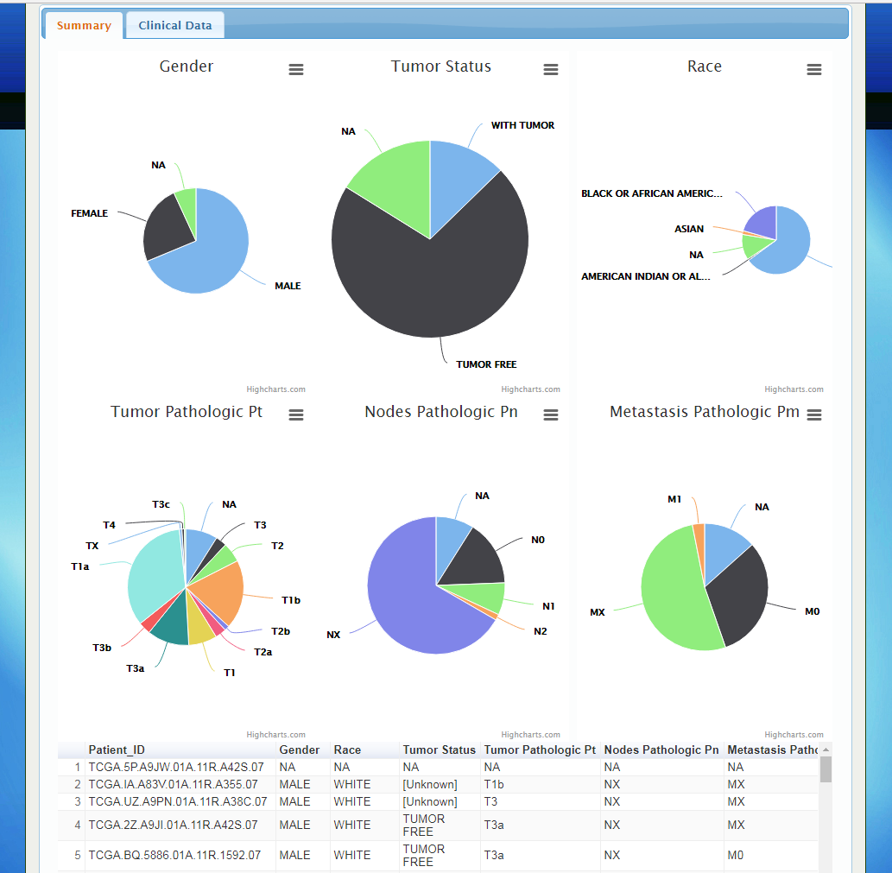
Kidney renal papillary cell carcinoma (KIRP)
Population Level – Summary and Distribution for Cancers
Patient Card Page – Customized Gene List Patient and Population Level Expression

Slide 35
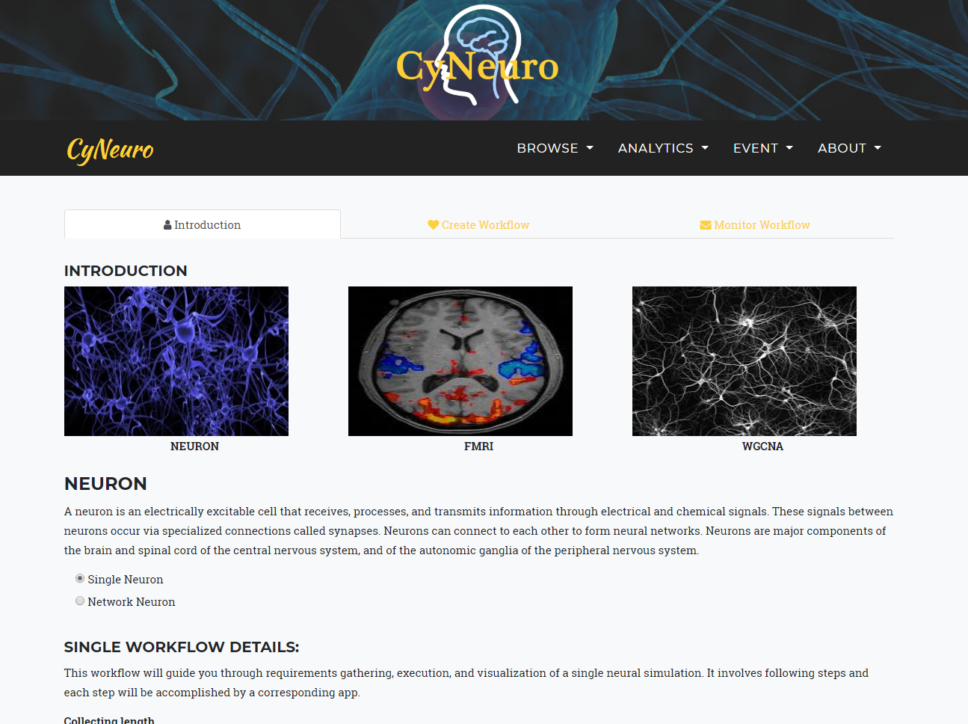
CyNeuro – NeuroScience Research

Slide 36
MaizeKB – NSF PGRP Projects
Physiological Genomics of Maize Nodal Root Growth under Drought (PI: Robert E. Sharp; CoPIs: David M. Braun, Felix B. Fritschi, Trupti Joshi, Scott C. Peck, Jonathan T. Stemmle and Melvin J. Oliver)
Genomic and Synthetic Approaches Linking Auxin Signaling to Functional Domains in Maize (PI: Paula McSteen; CoPIs: Jennifer Nemhauser, Andrea Gallavotti, Trupti Joshi, Britney Moss)
Multiomics dataset (transcriptomics, proteomics, metabolomics, Chipseq and DAPseq) from both projects incorporated in MaizeKB and utilize functionalities in KBCommons

Slide 37
MultiOmics Data Integrative Analysis
Physiological Genomics of Maize Nodal Root Growth under Drought (PI Sharp)
Utilized 18 samples for Lab FR697 studies with well watered (WW) and severe water deficit (WD) conditions for 3 regions (a,b,c) with 3 replicates each
3836 DEGs from 3 comparisons – Wwa_vs_WDa, WWb_vs_WDb & WWc_vs_WDc
569 metabolites expression data generated from these samples
Combined transcriptomics and metabolomics integrative analysis done with Mixomics (proteomics to be added later)

Slide 38
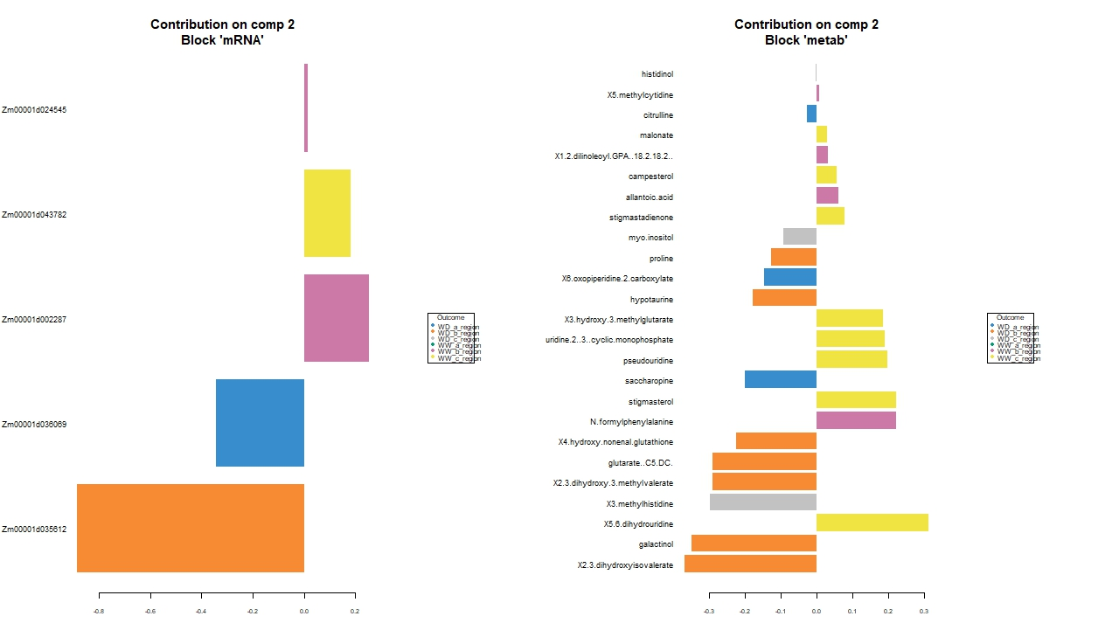
Multiomics Data Integration : Elements Contribution to Components
Component 1
Component 2
Negative | Positive
Negative | Positive
Negative | Positive
Negative | Positive
RNAseq
(6)
Metabolites
(10)
RNAseq
(5)
Metabolites
(25)

Slide 39
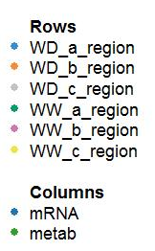
MultiOmics Data Integration : Clustered Heatmap Significant Elements
Tryptophan Positive Component 1
Negative Component 2
Negative Component 1 (except Tryptophan)
Positive Component 2
Component 2 -> Differentiates WW and WD with opposite expression patterns
Component 1 -> Differentiates Region A from B & C in both WW and WD with opposite expression patterns

Slide 40
Outline
Introduction
Translational Bioinformatics Tools and Genomic Solutions
SoyKB and KBCommons Knowledge Bases
PGen Workflow & SNPViz v2.0
Soybean Allele Catalog
IMPRes Algorithm and Tool
G2PDeep Method

Slide 41
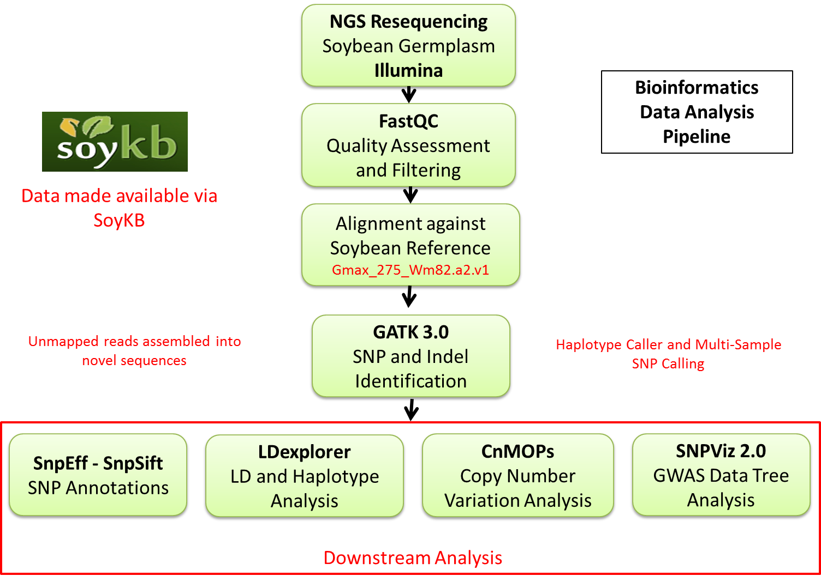
PGen Workflow for Genomic Variations
Resequencing of 1000+ soybean germplasm for better understanding of genomic variations and application to trait discovery (oil, protein, SCN, drought, heat and salt and root system architecture)
Resequencing data generated at 15X and 40X from USB funded project between MU and industry (Dow, Monsanto, Bayer)
Establish fast and efficient analysis pipelines for SNP & Indel identification and downstream analysis for improvements in soybean traits
PGen Workflow for SNP and Indel Calling
On XSEDE and Cyverse

Slide 42
PGen Workflow in SoyKB and GitHub
Web version :
http://soykb.org/Pegasus/index.php
GitHub :
https://github.com/pegasus-isi/PGen-GenomicVariations-Workflow
Liu et. al BMC Bioinformatics, 2016

Slide 43
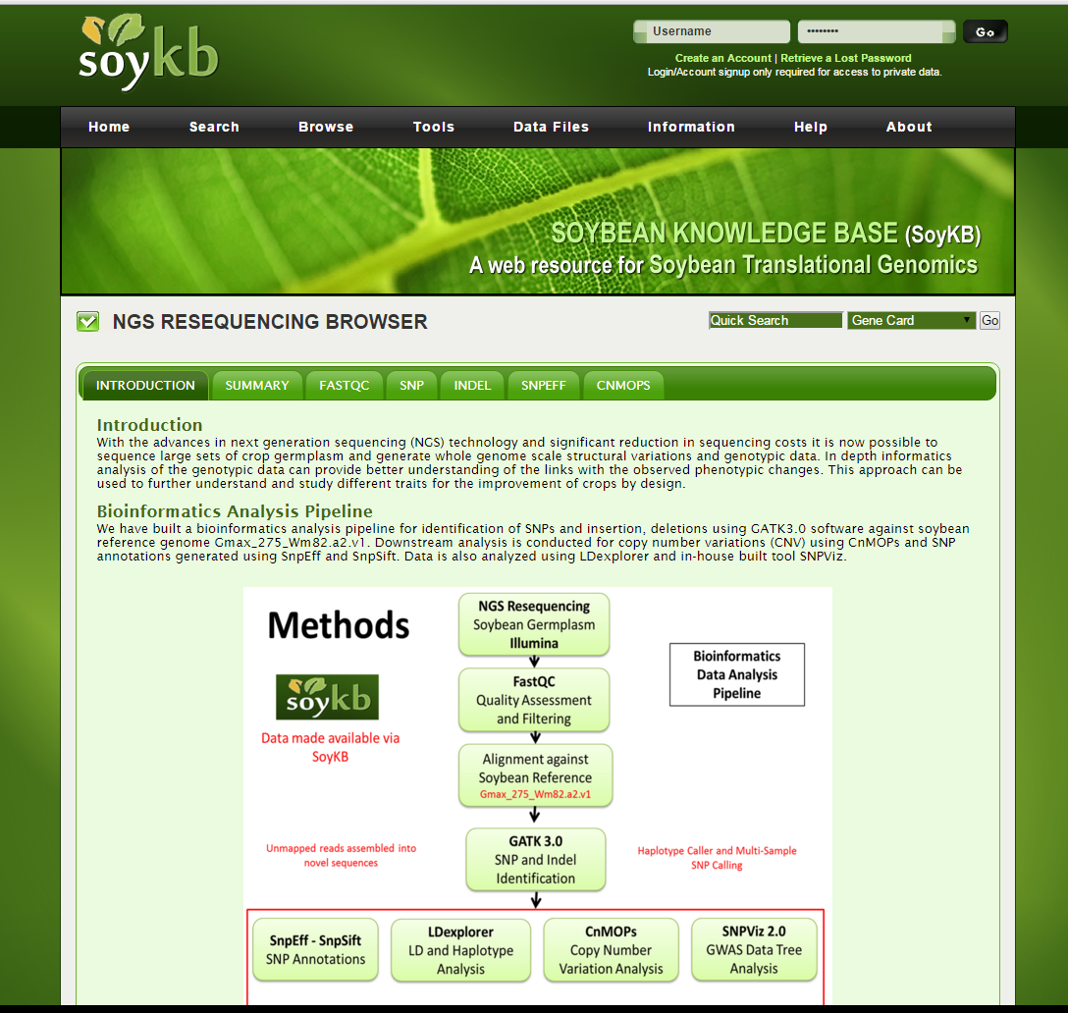
NGS Resequencing Data Browser
NGS Resequencing Data Browser
NGS Resequencing data shared at multiple tiers directly from iPlant data store
Incorporated in
SNP card pages
Gene card pages
Chromosome Visualizer
SNPViz Tool

Slide 44
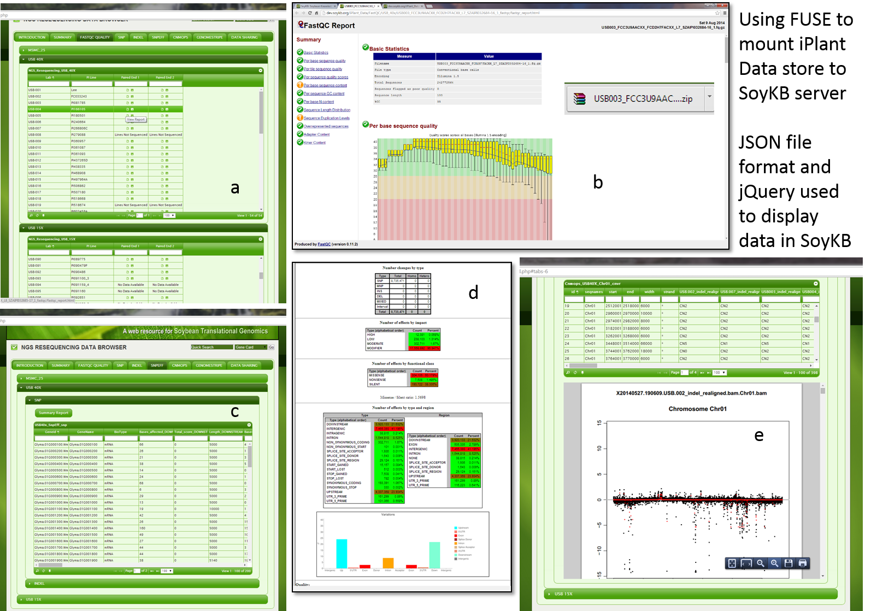
NGS Resequencing Data Browser
FastQC Quality
View and Download Reports
Copy Number Variations
SNP Annotations

Slide 45
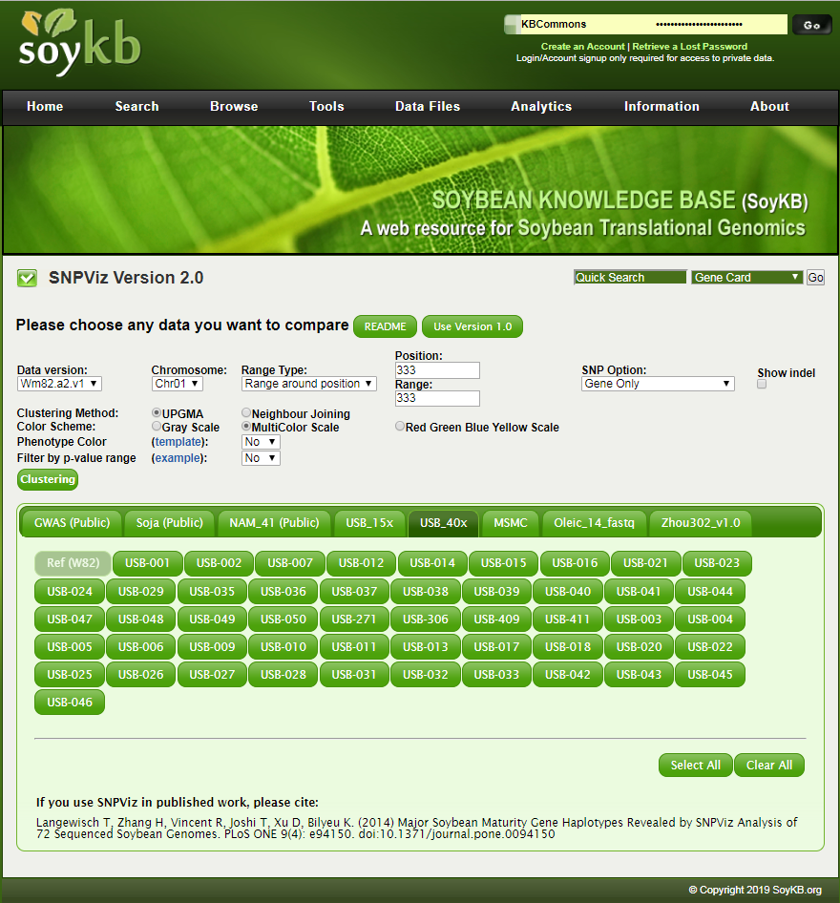
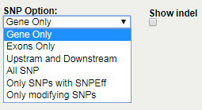
SNPViz v2.0: GWAS to Genes
Genome Version, Chromosome Position and Range Selection
Selection for SNP and Indels with filtering options for coding genes, surrounding regions and SNPEff annotations
Import GWAS significance pvalue and Phenotype Color
Langewisch et al. Plos One 2014
Zeng et al. BIBM 2020, IJDMB 2021
Tool developed in-house to enable efficient identification and translation of soybean genes that control phenotypes in breeding program using large scale GWAS and Resequencing based SNP datasets

Slide 46
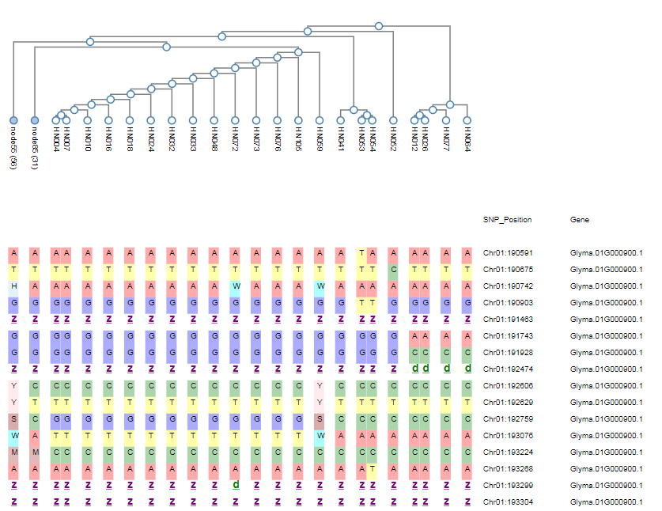
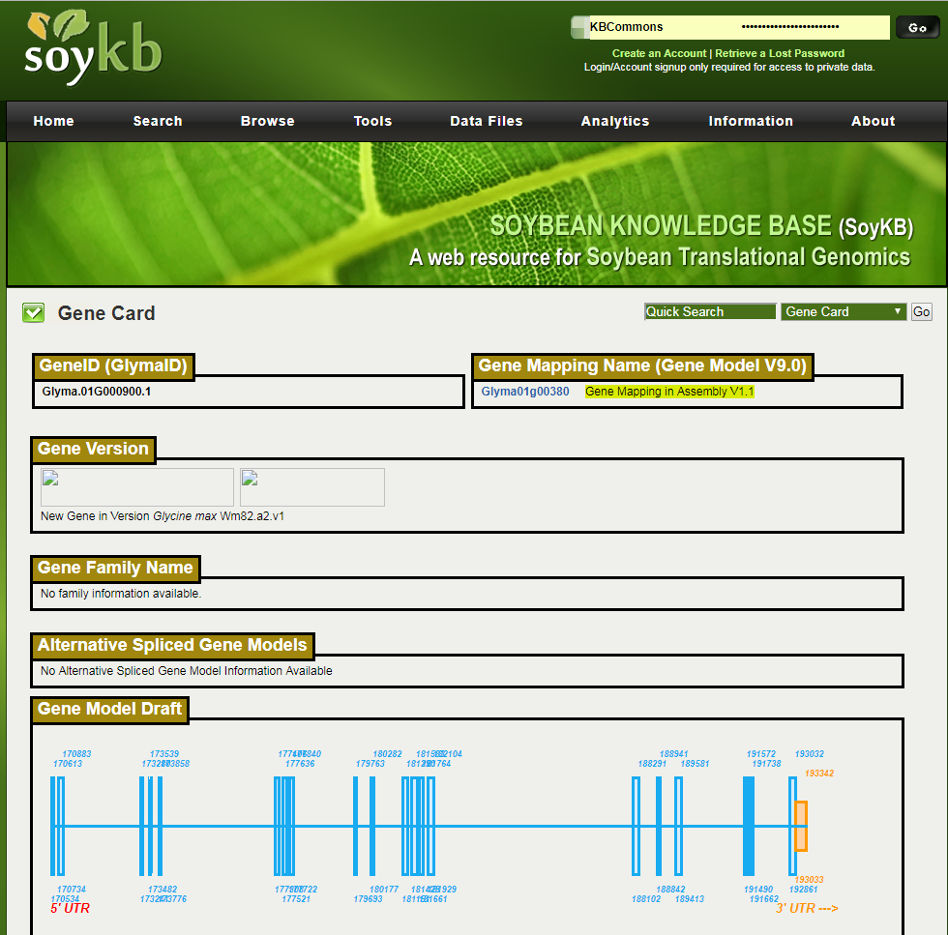
SNPViz v2.0:GWAS to Genes
Phylogeny tree
Annotation table
Haplotype
Gene Card
SNP, INDEL and SNPEff Annotation

Slide 47
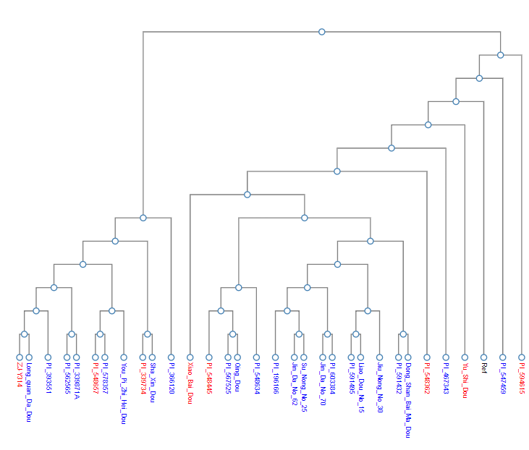
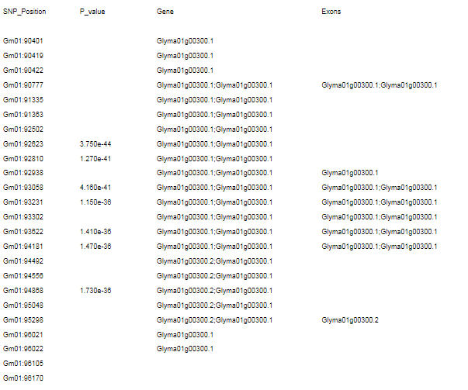
SNPViz v2.0: GWAS to Genes
Phenotype Color in Phylogeny tree
Showing P-value in annotation table

Slide 48
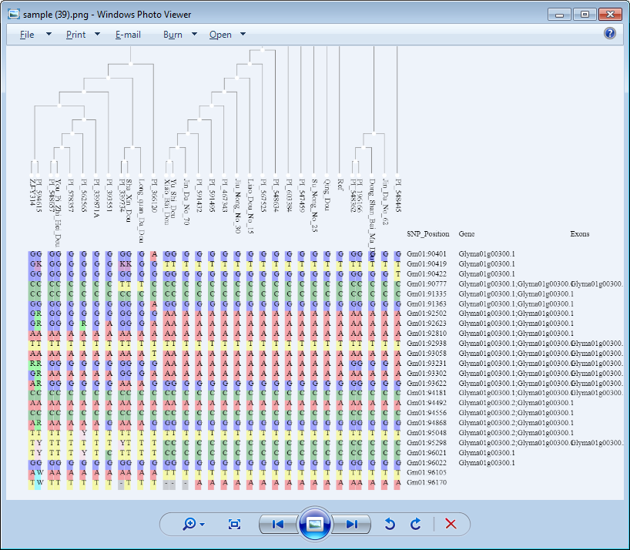
SNPViz v2.0: GWAS to Genes
Download Results

Slide 49
Outline
Introduction
Translational Bioinformatics Tools and Genomic Solutions
SoyKB and KBCommons Knowledge Bases
PGen Workflow & SNPViz v2.0
Soybean Allele Catalog
IMPRes Algorithm and Tool
G2PDeep Method

Slide 50
Soybean Allele Catalog
Developing a comprehensive understanding of soybean allele diversity and gene networks in the US soybean ancestors and released US soybean varieties.
Development of a framework for utilization of large scale genomics variations (SNPs and InDels) to generate a curated panel of diverse re-sequenced accessions that can be easily upgraded.
Explore various traits and provide context of genetic source, allele impact, and potential positive alternate alleles.

Slide 51
Soy775 Accession Panel
Soy775 accession panel. a: Pie chart representing resequenced data sets of 775 diverse soybean accessions; b: Distribution of G. soja, landraces, and elite accessions (190 US cultivars in total) in the resequenced data sets.

Slide 52
SnakyVC and AlleleCatalog Pipelines
AlleleCatalog pipeline
SnakyVC variant calling pipeline
Chan et al. 2021. In Preparation.

Slide 53
Soybean Allele Catalog
Query by multiple genes for grouped comparisons
Query by multiple accessions and a single gene to compare between accessions in the same gene
(1)
(2)

Slide 54
Soybean Allele Catalog
Provides counts of accessions based on improvement status of soybean, gene name and variant groups.
Highlighted important functional effects.
Missense_variant (Blue)
Stop_gained (Red)
Frameshift_variant (Red)
Splice_donor_variant (Green)
All the counts on the web page are clickable.
Data is directly downloadable.
(1)

Slide 55
Soybean Allele Catalog
(1)
Clicking the count displays more information about accessions that have been group together by same variants.

Slide 56
Soybean Allele Catalog
(2)
Users can query specific accessions of interest and gene of interest to perform a more straight forward comparison.
Users can compare accessions with different variant information of different improvement status groups better.

Slide 57
Soybean Allele Catalog and SNPViz Application to Protein Trait
Genescape analysis of the major protein/oil gene Glyma.15g049200 on chromosome 15 illustrating distribution of ancestral “higher protein/lower oil” allele among soybean varieties and “lower protein/higher oil” Williams 82 allele in North American (NA) cultivars.
Other alleles with one nucleotide frameshift in PI374207 can serve as a source of novel potentially defunct allele for breeding of new varieties for protein/oil content modulation.

Slide 58
Soybean Allele Catalog and SNPViz Application to Studying Protein Trait
SNPViz 2.0 visualization of landraces and US elite cultivars (bold) of the major protein/oil gene Glyma.15g049200 haplotype.
Accessions are colored based on protein/oil associated marker ss715637299 on chromosome 15 where red means higher protein/lower oil and blue lower protein/higher oil phenotype group.
The ancestral higher protein/lower oil allele is shown as insertion “i” and the novel defunct allele of PI374207 is shown as deletion “d”.

Slide 59
Outline
Introduction
Translational Bioinformatics Tools and Genomic Solutions
SoyKB and KBCommons Knowledge Bases
PGen Workflow & SNPViz v2.0
Soybean Allele Catalog
IMPRes Algorithm and Tool
G2PDeep Method

Slide 60
Method Flowchart
IMPRes: Integrative Multi-Omics Pathway Resolution Algorithm and Tool
Inputs
Omics Data
Transcriptomics, Proteomics, Metabolomics
Seed genes (root nodes where the pathways begin) such as receptor, mutated gene, gene of interest
KEGG Pathways RDF network for 250+ pathways
Protein Interaction (PPI)
Jiang et al. Bioinformatics 2019; Methods 2019; BIBM 2018

Slide 61
IMPRes: Integrative Multi-Omics Pathway Resolution Algorithm and Tool
In Silico Hypothesis Generation
Maize nodal root growth zone “a” during drought stress

Slide 62
IMPRes v1.0: Web Tool Tutorial
http://digbio.missouri.edu/impres
Jiang et al. Bioinformatics 2019; Methods 2019; BIBM 2018

Slide 63
Outline
Introduction
Translational Bioinformatics Tools and Genomic Solutions
SoyKB and KBCommons Knowledge Bases
PGen Workflow & SNPViz v2.0
Soybean Allele Catalog
IMPRes Algorithm and Tool
G2PDeep Method

Slide 64
G2PDeep
G2PDeep is a web server for phenotype prediction and genotype markers discovery.
G2PDeep offers the first web -based customizable deep-learning framework for quantitative phenotypes prediction, and saliency for genotype markers discovery.
http://g2pdeep.org/
Zeng et al. 2021 NAR Web Server

Slide 65
G2PDeep
It takes genotypic (SNP) information from plants and animals as the input for model training, and it will automatically deploy trained models after the training process.
It is a platform for researchers to create deep-learning models through an interactive web interface and train these models with uploaded data using high-performance computing resources.
Applied to SoyNAM dataset for soybean.
Predicted results
Saliency results

Slide 66
Summary
Translational Bioinformatics tools provide great opportunities to incorporate genomics and multiomics information into advancing research and applications.
Several translational bioinformatics tools and multiomics integration frameworks are available including
SoyKB and KBCommons – Knowledge Base Framework & Tools
PGen Workflow & SNPViz v2.0
Soybean Allele Catalog
IMPRes Algorithm and Tool
G2PDeep

Slide 67
Emerging Trends
https://technosanta.com/ai-in-agriculture/

Slide 68
Acknowledgements
SoyKB - KBCommons Development Team
Shuai Zeng (CS)
Zhen Lyu (CS)
Yen On Chan (MUIDSI)
Bioinformatics Team
Jeuxin Wang (Research Scientist)
Yuexu Jiang (Postdoc)
Sidharth Sen (MUIDSI)
Key Collaborators
Dr. Dong Xu (EECS)
Dr. Kristin Bilyeu
Dr. Maria Skrabisova
Funding Support
NSF Award # IOS-1444448 ; # IOS-1546873 ; # IOS-2110017
NSF Award # OAC-1827177
USB #1920-152-0131-C ; #2220-152-0202
NIH 5UL1TR002345-02

Slide 69
Weblinks and Contact Details
Digital Biology Laboratory
http://digbio.missouri.edu
Soybean Knowledge Base
https://soykb.org/
KBCommons Knowledge Base
https://kbcommons.org/
Contact : Joshitr@missouri.edu

