Slide 1
Developing the Global Conservation Strategy for Coffee Genetic Resources Sarada Krishnan, Ph.D.

Slide 2
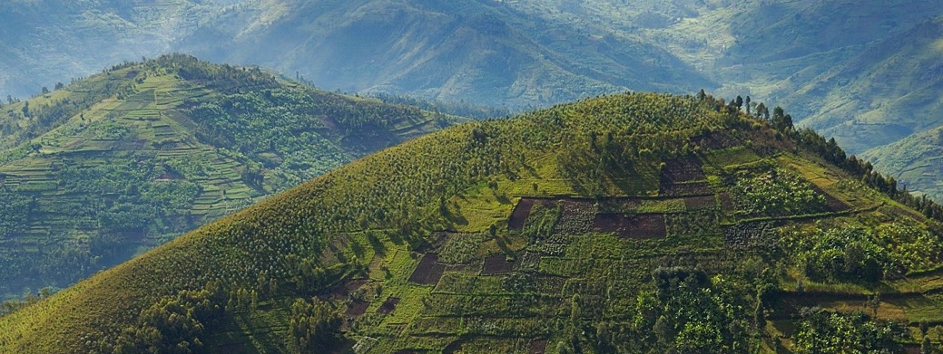
To grow, protect, and enhance supplies of quality coffee while improving the livelihoods of the families who produce it.

Slide 3
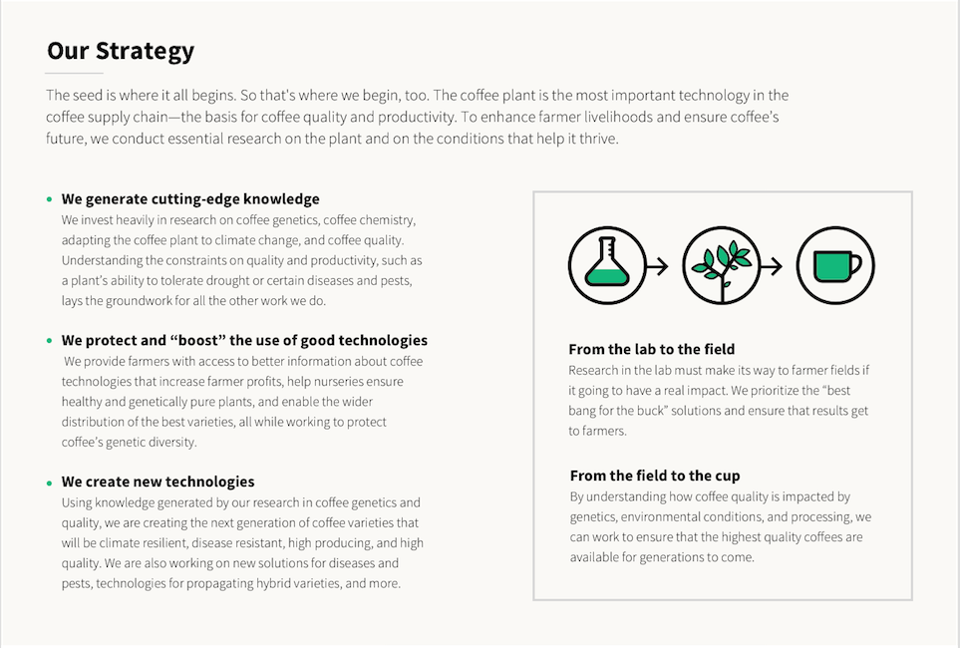

Slide 5
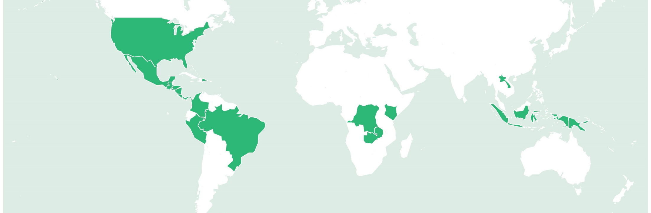
A global network Funded by industry. Guided by producers. Executed by scientists. 20+ institutions.

Slide 6
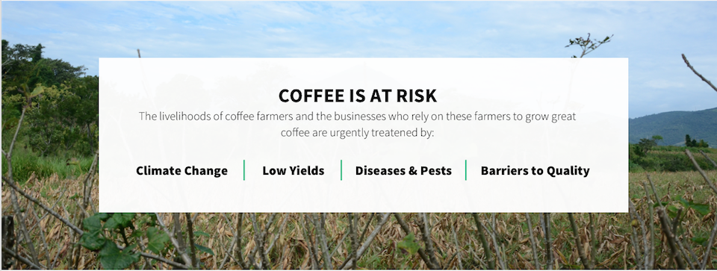

Slide 7
Coffee Needs to be Conserved
Coffee genetic resources are being lost at a rapid pace
Most of the main collections of coffee are in disrepair and its natural habitat is rapidly disappearing
leading to genetic erosion

Slide 8
A Joint Initiative
There is currently no global conservation strategy for coffee
World Coffee Research and the Crop Trust are announcing today the development of a Global Conservation Strategy for Coffee

Slide 9
Strategy Development
Background document for the global conservation strategy
Current understanding of the status of the major coffee collections
Understanding of the major gaps in these collections or their conservation
Understanding of the current in situ and complementarity ex situ collections of coffee germplasm and its wild relatives

Slide 10
The Objective
Identify high priority actions that need to be taken and ensure commitment by the coffee community to invest in these actions
Securing long term conservation of globally available coffee through the Crop Trust’s Crop Diversity Endowment Fund

